Slide 1
Damped simple harmonic motion
27th August 2019

Slide 2
Phase space
In classical mechanics, the phase space is the space of all possible states of a system; the state of a mechanical system is defined by the constituent positions and velocities or momenta.
The horizontal coordinate represents the position x while the vertical coordinate represents the velocity v.
The future state of motion of such a particle is completely specified if its positon and velocity are know simultaneously.
The trajectory of these points in phase space represents the complete time history of the particle.
Notes:
Phase space is actually a special space describing the motion of an object from the past to the possible future.

Slide 3
Simple harmonic oscillator : no damping force
A general solution for simple harmonic motion may be written as
The corresponding velocity is found to be
The trajectory of the oscillator in the phase space becomes
The motion repeats itself, a consequence of the conservation of the total energy of the harmonic oscillator.

Slide 4
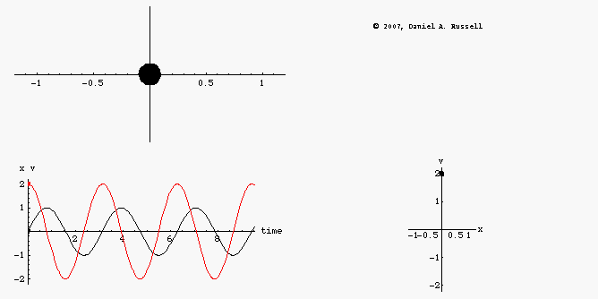
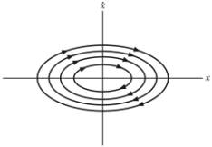
Phase space diagram for undamped oscillator
An object undamped oscillating back and forth along x axis
Position x(t) (leads/lags) velocity v(t) by …..rad
The phase diagram plot (phase space) is a combined plot of x(t) and v(t) giving a clockwise ellipse.
What happens when the amplitude of the motion is differed.?
http://www.acs.psu.edu/drussell/Demos/phase-diagram/phase-diagram.html
http://teacher.pas.rochester.edu/PHY235/LectureNotes/Chapter03/Chapter03.htm
Notes:
Position x(t) lags velocity v(t) by 90 degrees
All possible points in a phase space plane is a result of the motion of a single particle whose motion is restricted to lie along a single spatial coordinate.
Different elliptical trajectories can be obtained from different amplitudes.

Slide 5
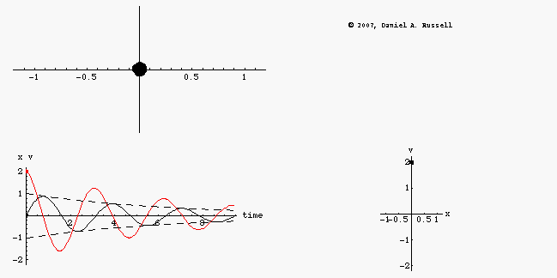
Phase space diagram for (lightly) damped oscillator
The oscillator loses energy during each cycle.
x(t) and v(t) exponentially decrease in amplitude as time proceeds.
In classical mechanics, this phase space described as an "attractor" .
http://www.acs.psu.edu/drussell/Demos/phase-diagram/phase-diagram.html

Slide 6
Damped simple harmonic motion
Equation of motion
General solution for the differential equation
Where t = time and C₁, C₂ are arbitrary constants.

Slide 7
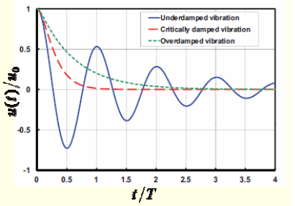
Three possible conditions
(1) Heavy damping :
(2) Critically damping:
(3) Lightly damping:
Displacement as function of time for a one-dimensional damped oscillator
https://www.quora.com/What-is-damping-ratio
Notes:
Heavy damping = supercritical damping, overdamping

Slide 8
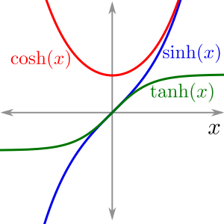
Heavy damping
To illustrate the behavior of the heavy damping (over damping), the displacement x(t) can be rewritten as
Where
This represents non-oscillating behavior.
http://calculus.seas.upenn.edu/?n=Main.ComputingTaylorSeries
Notes:
The motion is an exponential decay with two different decay constants, (p+q) and (p-q).
The oscillation is prevented by the strong damping force.
There is no trace of oscillatory motion.
Cosh z = (1/2)(e^z + e^-z)
Sinh z = (1/2)(e^z -e^-z)

Slide 9
Derivation of the heavy damping displacement x

Slide 10
Heavy damping graph
Given an initial condition x(t=0) = 0.
The displacement x(t) is written as
x(t) = ………………………………….
The graph returns to zero displacement quite slowly without oscillating about its equilibrium position.
Notes:
An important point here is non oscillation behavior of the object when approaching an equilibrium.

Slide 11
Critically damping
Under the critically damping, the displacement becomes
Where A is a constant length and B is a given velocity which depends on the boundary conditions.
Suppose a critical damping system
has zero displacement at t = 0 and receives
an impulse which gives it an initial velocity V.
Determine the maximum displacement.
Also the motion is non-oscillatory.
Notes:
Using given initial conditions, A = 0 and B = V.
Then use dx/dt = 0 to determine time t corresponding to the maximum displacement.
Substituting the calculated t to determine the maximum displacement.
The maximum displacement is found to be xmax = 0.368V/p

Slide 12
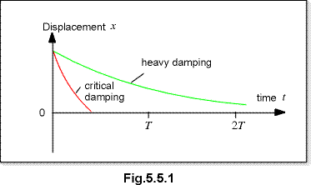
Comparison between heavy damping and critical damping
Heavy damping of a damped oscillator will cause it to approach zero amplitude more slowly than for the case of critical damping.
Critical damping is of practical importance in mechanical oscillators which experience sudden impulses and required to return to displacement in minimum time.
Notes:
Overdamping of a damped oscillator will cause it to approach zero amplitude more slowly than for the case of critical damping. The damping coefficient is greater than the undamped resonant frequency .

Slide 13
Lightly damping
The behavior of the lightly damping oscillating system is described by
The amplitude of the oscillator decays exponentially with time according to
The damping coefficient r controls how fast the oscillating system comes to rest.

Slide 14
Analysis of the lightly damping displacement
Referring to
The bracket has the dimensions of frequency and can be written as
and ω = frequency of ideal simple harmonic frequency (no damping!)
Therefore, ; provided that
A and φ are constants which depend on the motion at t = 0.
This lightly damping oscillation can then be compared to the simple harmonic oscillation.
Notes:
โดยสรุปคือใน slide นี้เราต้องการจัดรูป x(t) เป็น harmonic function ซึ่งถ้าจัดได้แสดงว่า displacement มีการแกว่งไปมารอบจุดสมดุล
ทำได้สองทางคือ
เริ่มจากการที่ต้องการ displacement เป็นจำนวนจริง ซึ่งจะเป็นจริงได้ก็ต่อเมื่อ C1 และ C2 เป็น complex conjugate ซึ่งกันและกัน และค่า C1, C2 กำหนดให้ตามที่เห็นใน slide
2. อาศัย boundary conditions ที่ t =0 ให้ x = Asinφ โดยที่ A และ φ เป็นค่าคงตัว เมื่อให้ t = 0 จะได้ว่า x(t =0) = Asinφ = C1 + C2 เมื่อ ค่า C1, C2 กำหนดให้ตามที่เห็นใน slide

Slide 15
Derivation of lightly damping displacement x
TRY PROBLEM 2.3

Slide 16
Differences between the undamped oscillation and underdamped oscillation
Recall, the undamped oscillatory displacement :
The underdamped oscillatory displacement :
There are two difference : (1) the presence of the real exponential factor leading to a gradual death of oscillations and (2) the underdamped oscillator’s angular frequency.
The underdamped oscillator vibrates a little more slowly than does the undamped oscillator.
The period of underdamped oscillator is given by

Slide 17
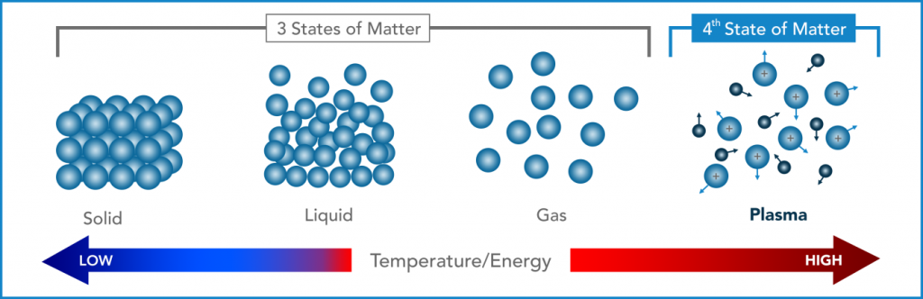
Plasma oscillations-what is plasma?
Plasma is simply an ionized or electrically charged gas, and is often described as the fourth state of matter, i.e. when energy is added to a solid (first state) it becomes a liquid (second state); with more added energy it becomes a gas (third state) and when further energy is added it eventually disassociates to become a plasma.
https://tetronics.com/our-technology/what-is-plasma/

Slide 18
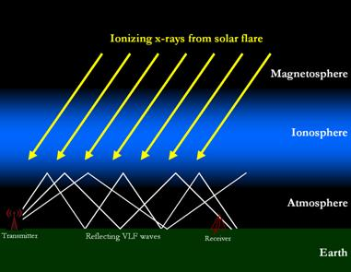
Plasma oscillation : the ionosphere
The ionosphere is defined as the layer of the Earth's atmosphere ionized by solar and cosmic radiation. It lies 75-1000 km above the Earth.
Because of the high energy from the Sun and from cosmic rays, the atoms in this area have been stripped of one or more of their electrons, or “ionized,” and are therefore positively charged. The ionized electrons behave as free particles. The particles are in the plasma state.
The ionosphere influences radio propagation to distant places on the Earth, and between satellites and Earth.
http://solar-center.stanford.edu/SID/activities/ionosphere.html

Slide 19
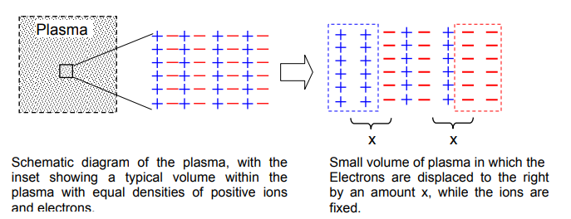
Plasma oscillations : Plasma characteristics
The plasma is overall neutral, i.e., the number density of the electrons and ions are the same.
http://homepage.physics.uiowa.edu/~rmerlino/129Fall12/29_129_Plasma_oscillations.pdf
Notes:
Note the number density refers an amount of particle in any volume.
The displacement occurs to the electron because its mass is extremely smaller than the mass of an ion.

Slide 20
Plasma oscillation : the analysis
The positive region on the left side and the negative region on the right side can be considered as two parallel charged planes, each having a cross sectional area and width x.
TRY PROBLEM 2.8
Notes:
Information for electric filed between two oppositely charged parallel plates can be found from
https://web.pa.msu.edu/courses/2000fall/PHY232/lectures/gausscond/simplegeoms.html

Slide 21
Energy Consideration
The total energy of the damped harmonic oscillator is given by
Differentiate the total energy with respect to t :
From the equation of motion of the damped oscillation :
The time rate of change of total energy is found to be the product of the damping force and the velocity
Because this always either zero (undamped) or negative (underdamped), the total energy continually decreases.
Notes:
dE/dt = the rate of energy loss
The rate of energy of the damped harmonic oscillation becomes loss.

Slide 22

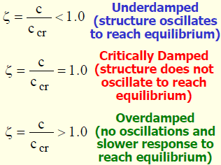
Damping ratio
Damping Ratio (ζ = zeta) is dimensionless parameter which describes how an oscillating or vibrating body comes to rest.
https://www.quora.com/What-is-damping-ratio
Notes:
Notice that if the system damping coefficient C is less than the critical damping coefficient Ccr, the system oscillates before coming to rest.
On the contrary, if the ratio is greater than 1, the system doesn’t oscillate and comes to rest quickly.

Slide 23
What is the damping ratio ζ?
The damping ratio gives the level of damping in a system relative to critical damping.
The damping ratio can be defined as the ratio of the damping coefficient in the system's differential equation to the critical damping coefficient.
Example 1 : A spring-mass damper system has mass of 100 kg, stiffness of 3000 N/m and damping coefficient of 300 kg/s. Calculate the undamped natural frequency, the damping ratio and the damped natural frequency. Does the system oscillate?

Slide 24
solution

Slide 25
Values for describing the damping of an oscillator
Three different values are used to describe the behavior of a damped oscillator.
They are composed of (1) Logarithmic decrement, (2) Relaxation time and (3) Quality Factor or Q-Value.
The exponential decay factor exp(-rt/2m) expresses the rates at which the amplitude and energy is reduced.
Notes:
ค่าต่าง ๆ ที่ใช้บรรยายพฤติกรรมของการสั่น ไม่ว่าจะเป็น logarithm decrement relaxation time และ quality factor หรือ Q value สามารถนำมาหาค่า damping coefficient r เนื่องจากเป็นค่าเดียวที่ปรากฏในระบบ (นอกเหนือจาก ค่า มวล m และ ค่า stiffness s ที่สามารถวัดได้โดยตรง)

Slide 26
Logarithmic decrement (1)
This value represents the rate at which the amplitude decreases with time.
Suppose the expression of the lightly damped oscillation,
Given φ = π/2 and at t = 0, x = A₀.
The lightly damped can be described by
The behavior is shown as ------------->

Slide 27
Logarithmic decrement (2)
From the graph in the previous slide, the amplitude at n^{th} period can be written as
For example
Notice that
The logarithmic decrement
Notes:
A0/A1 = A1/A2 =…=An-1/An = exp (rτ’/2m) = constant
Logarithmic decrement δ = rτ’/2m
Logarithmic decrement is the natural logarithm of the ratio of two successive amplitudes that are separate by a period τ’; the larger amplitude being the numerator.

Slide 28
Example 2
The frequency of a damped harmonic oscillator is one-half the frequency of the same oscillator with no damping. Find the ratio of the maxima of successive oscillations.
The ratio of the maxima of successive oscillations is given by
This oscillator is classified a highly damped oscillator.

Slide 29
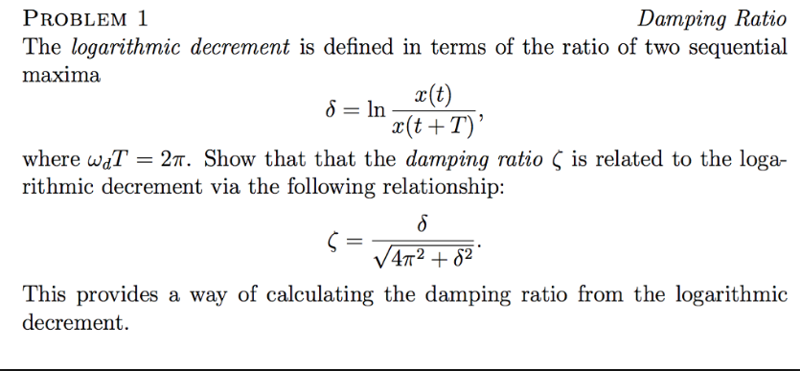
Example 3
Notes:
https://www.chegg.com/homework-help/questions-and-answers/damping-ratio-problem-1-logarithmic-decrement-defined-terms-ratio-two-sequential-maxima-t--q26849775
Once the damping ratio is known, the damping coefficient of the system can be determined.

Slide 30
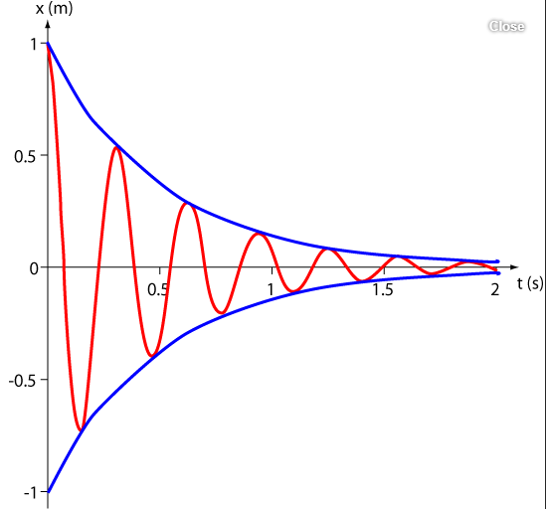
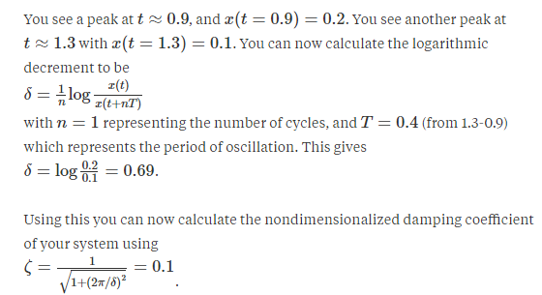
Example 4
Determination of logarithmic decrement
Damping ratio
The value corresponds to the underdamping system.
https://www.quora.com/What-is-the-use-of-logarithmic-decrement

Slide 31
Relaxation time
This expresses the damping effect on the motion in terms of the time taken by the amplitude to decrease by a factor of ((1/e) = 0.368) of its original amplitude; e = 2.718.
The relaxation time or modulus of decay is denoted as τ.
From the expression
The relaxation time is a measure of how rapidly the motion is damped out by friction. The higher the value of r, the shorter the relaxation time.

Slide 32
Quality Factor or Q-Value (1)
The reduction of the total energy of the damped oscillator depends on the exponential decay factor given by
The time for the energy E to decay to E₀e⁻¹ is given by t = m/r.
During this time the oscillator will have vibrated through .
The ratio is defined as the quality factor .
This expresses the number of radians through which the damped system oscillates as its energy decays to E₀e⁻¹
Notes:
The energy is proportional to the energy squared.

Slide 33
Quality Factor or Q-Value (2)
The rate of energy loss is given as dE/dt where E = E₀exp(-rt/m).
If a time interval corresponding to the energy decay is given by t’ (equivalent to the period of oscillation), the energy loss becomes -ΔE = (dE/dt)t’.
Because dE/dt = (-r/m)E₀e^{-rt/m} and
This leads to
In summary, Q is a measure of the rate at which an oscillator loses energy.
Notes:
The higher the Q of the oscillator and thus the narrower the bandwidth, the more stable the output of the frequency of the circuit.

Slide 34
Analysis of the Q value
The amplitude decay follows exp(-r/2m)t.
Since energy ∝ amplitude squared, the decay term becomes exp(-r/m)t.
The time taken for energy to change from E_{o}exp(-r/2m)t to E_{o}exp(-1) is found to be m/r.
Since over one period τ’ corresponding to 2π redians change,
for m/r the radian change becomes (2π/τ’)(m/r) = ω’m/r. This quantity is known as Q value.
Now, if we consider the rate of energy change dE/dt = (-r/m)E_{o}exp(-r/2m)t = (-r/m)E.
If the time interval dt is chosen to be τ’, dE becomes ΔE (energy loss per cycle) and E becomes a stored energy.
Therefore, E/-ΔE=m/(rτ’). And due to Q = ω’m/r, E/-ΔE=Q/2π.
The Q value expresses the ratio of the stored energy in an oscillator to the energy lost per cycle.

